Slide 1
Advance web scraping
A 3-days training program
Asadh 7-9, 2081
Dr. Anil Shrestha
Undersecretary (Account)
Financial Administration Section
National Statistics Office

Slide 2
Outline
Session 1: Introduction to web scraping
Session 2: Excel and Google Sheets for web scraping
Excel’s Web Query
Google Sheets’ IMPORTHTML() and IMPORTDATA() functions for basic scraping.
Google Sheets’ IMPORTXML() function for advance scraping.
Session 3: Setting up R and Python for web scraping
Session 4: Web scraping with R
Session 5: Web scraping with Python

Slide 3
Introduction to web scraping

Slide 4
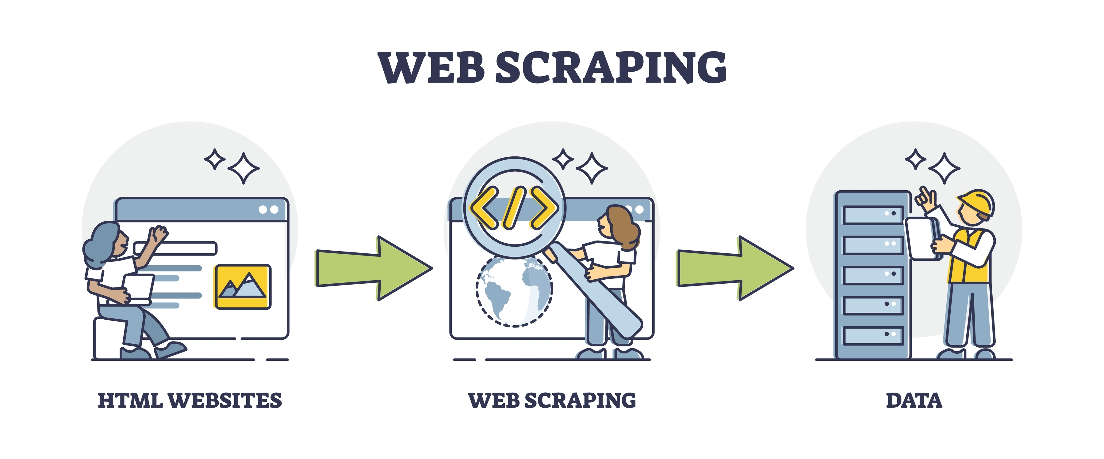
What is web scraping?
An automated extraction of data from websites.

Slide 5
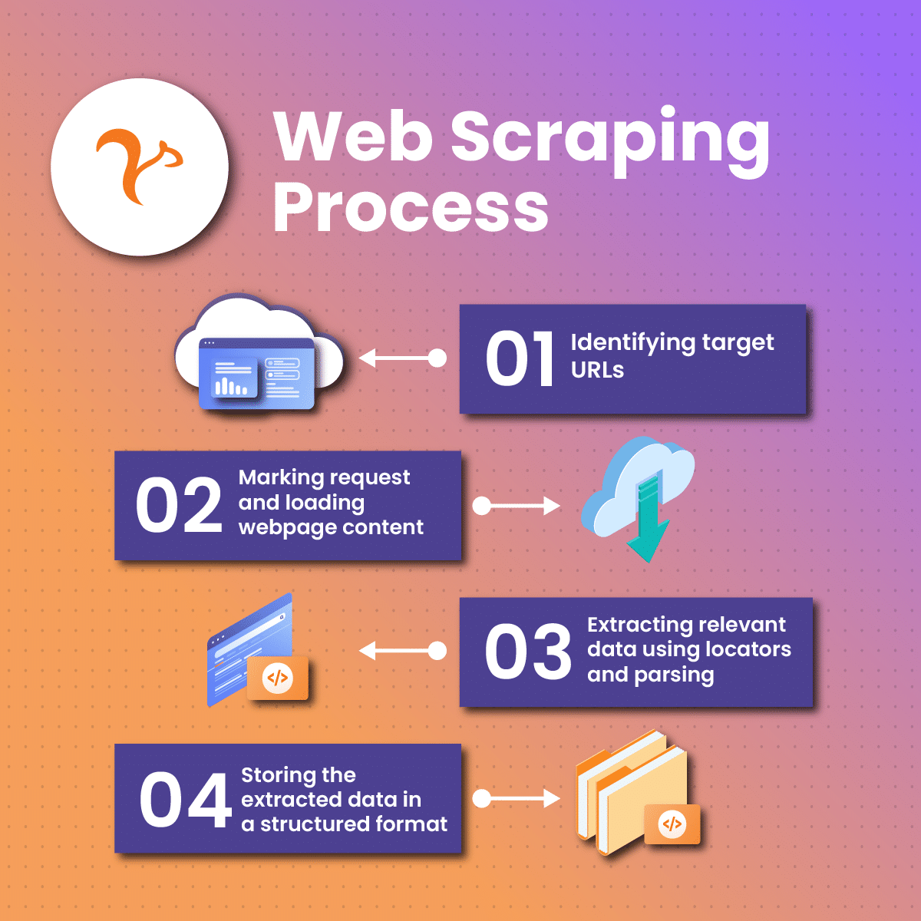
Process of web scraping
Fetching web page and its html source.
Understanding the structure of the web page HTML code.
Extracting the desired data (product, prices, reviews etc.)
Cleaning, manipulating, and storing the data.

Slide 6
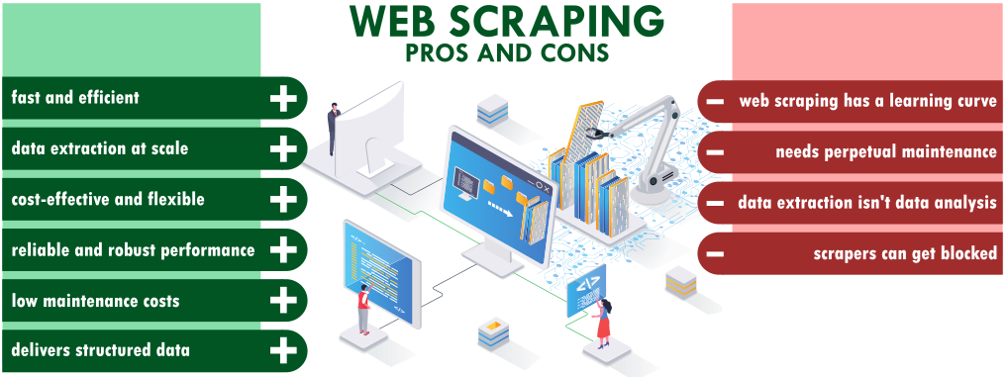
Why use web scraping?

Slide 7
Web scraping: Demo

Slide 8
Demo
Web scraping data of today’s share prices of NEPSE from https://www.sharesansar.com/today-share-price using excel, google sheet, R, and Python.
#python code
import pandas as pd
df = pd.read_html("https://www.sharesansar.com/today-share-price")[0]
print(df)
df.to_csv('share.csv')
#R code
library(rvest)
df <- html_table(read_html("https://www.sharesansar.com/today-share-price"))[[1]]
View(df)
write.csv(df, file = 'share.csv')

Slide 9
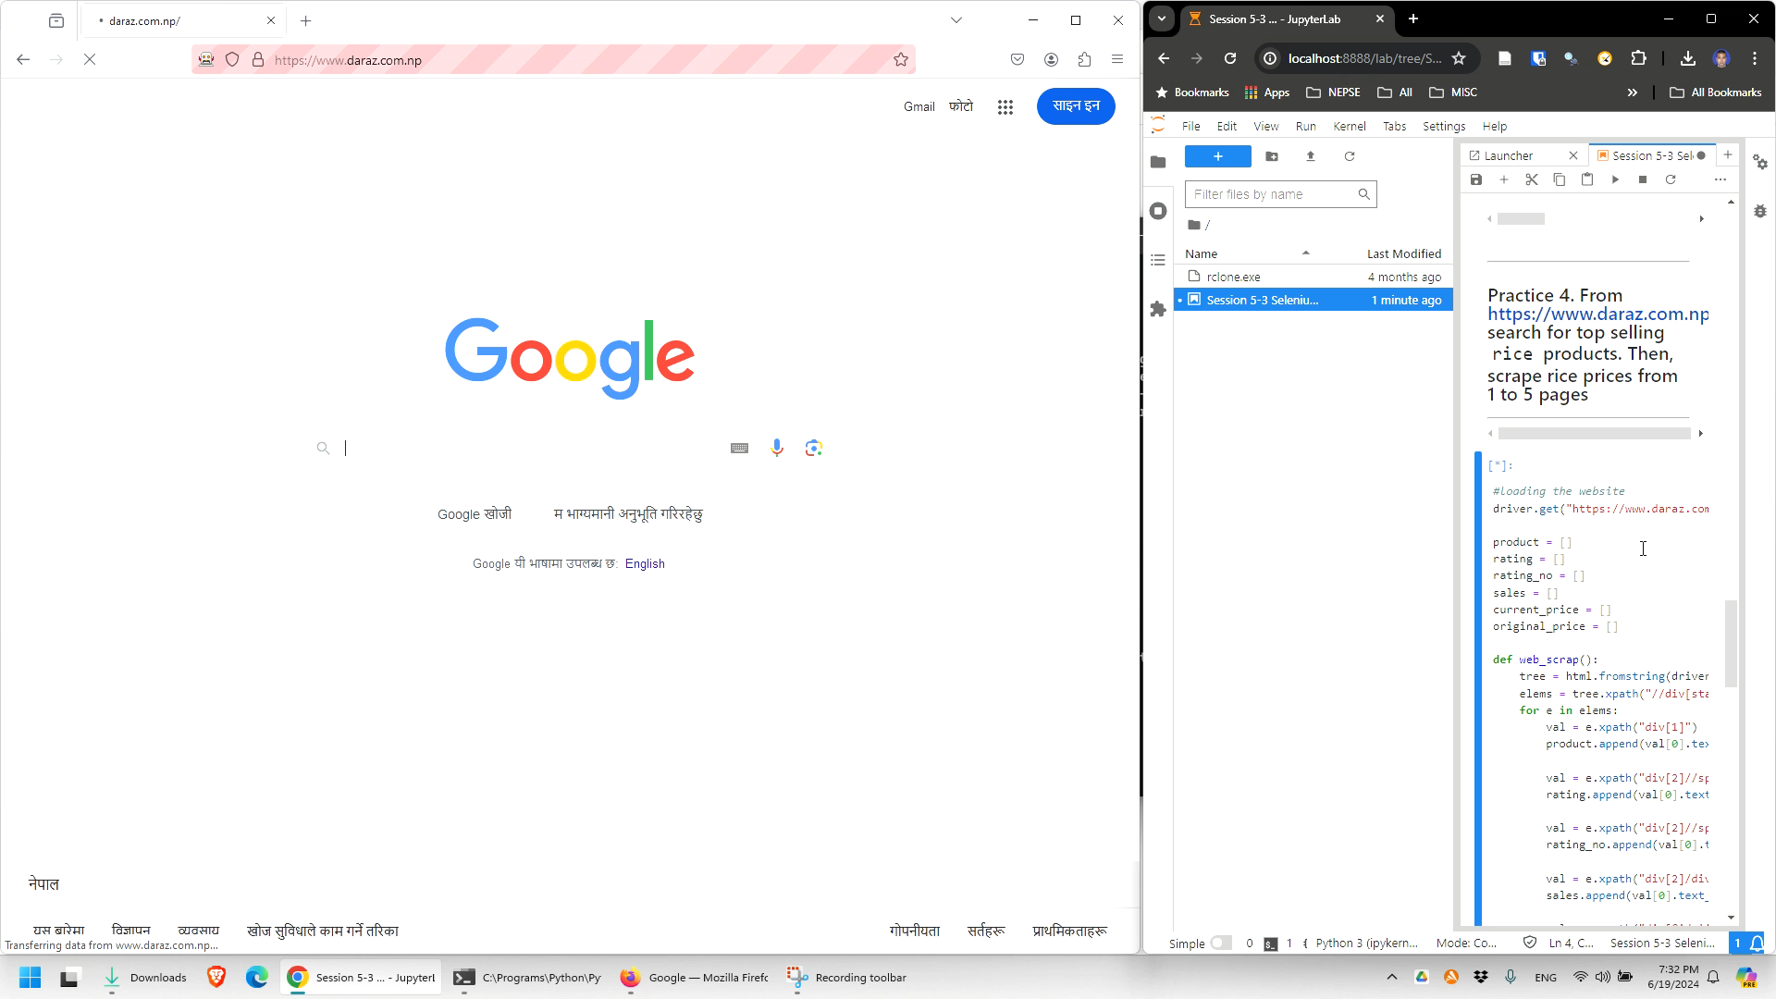
The ultimate target

Slide 10
Thank you

